Slide 1
ne_mono_5wtiv
All Monopile Pipeline
Add 3 WTIV

Slide 2
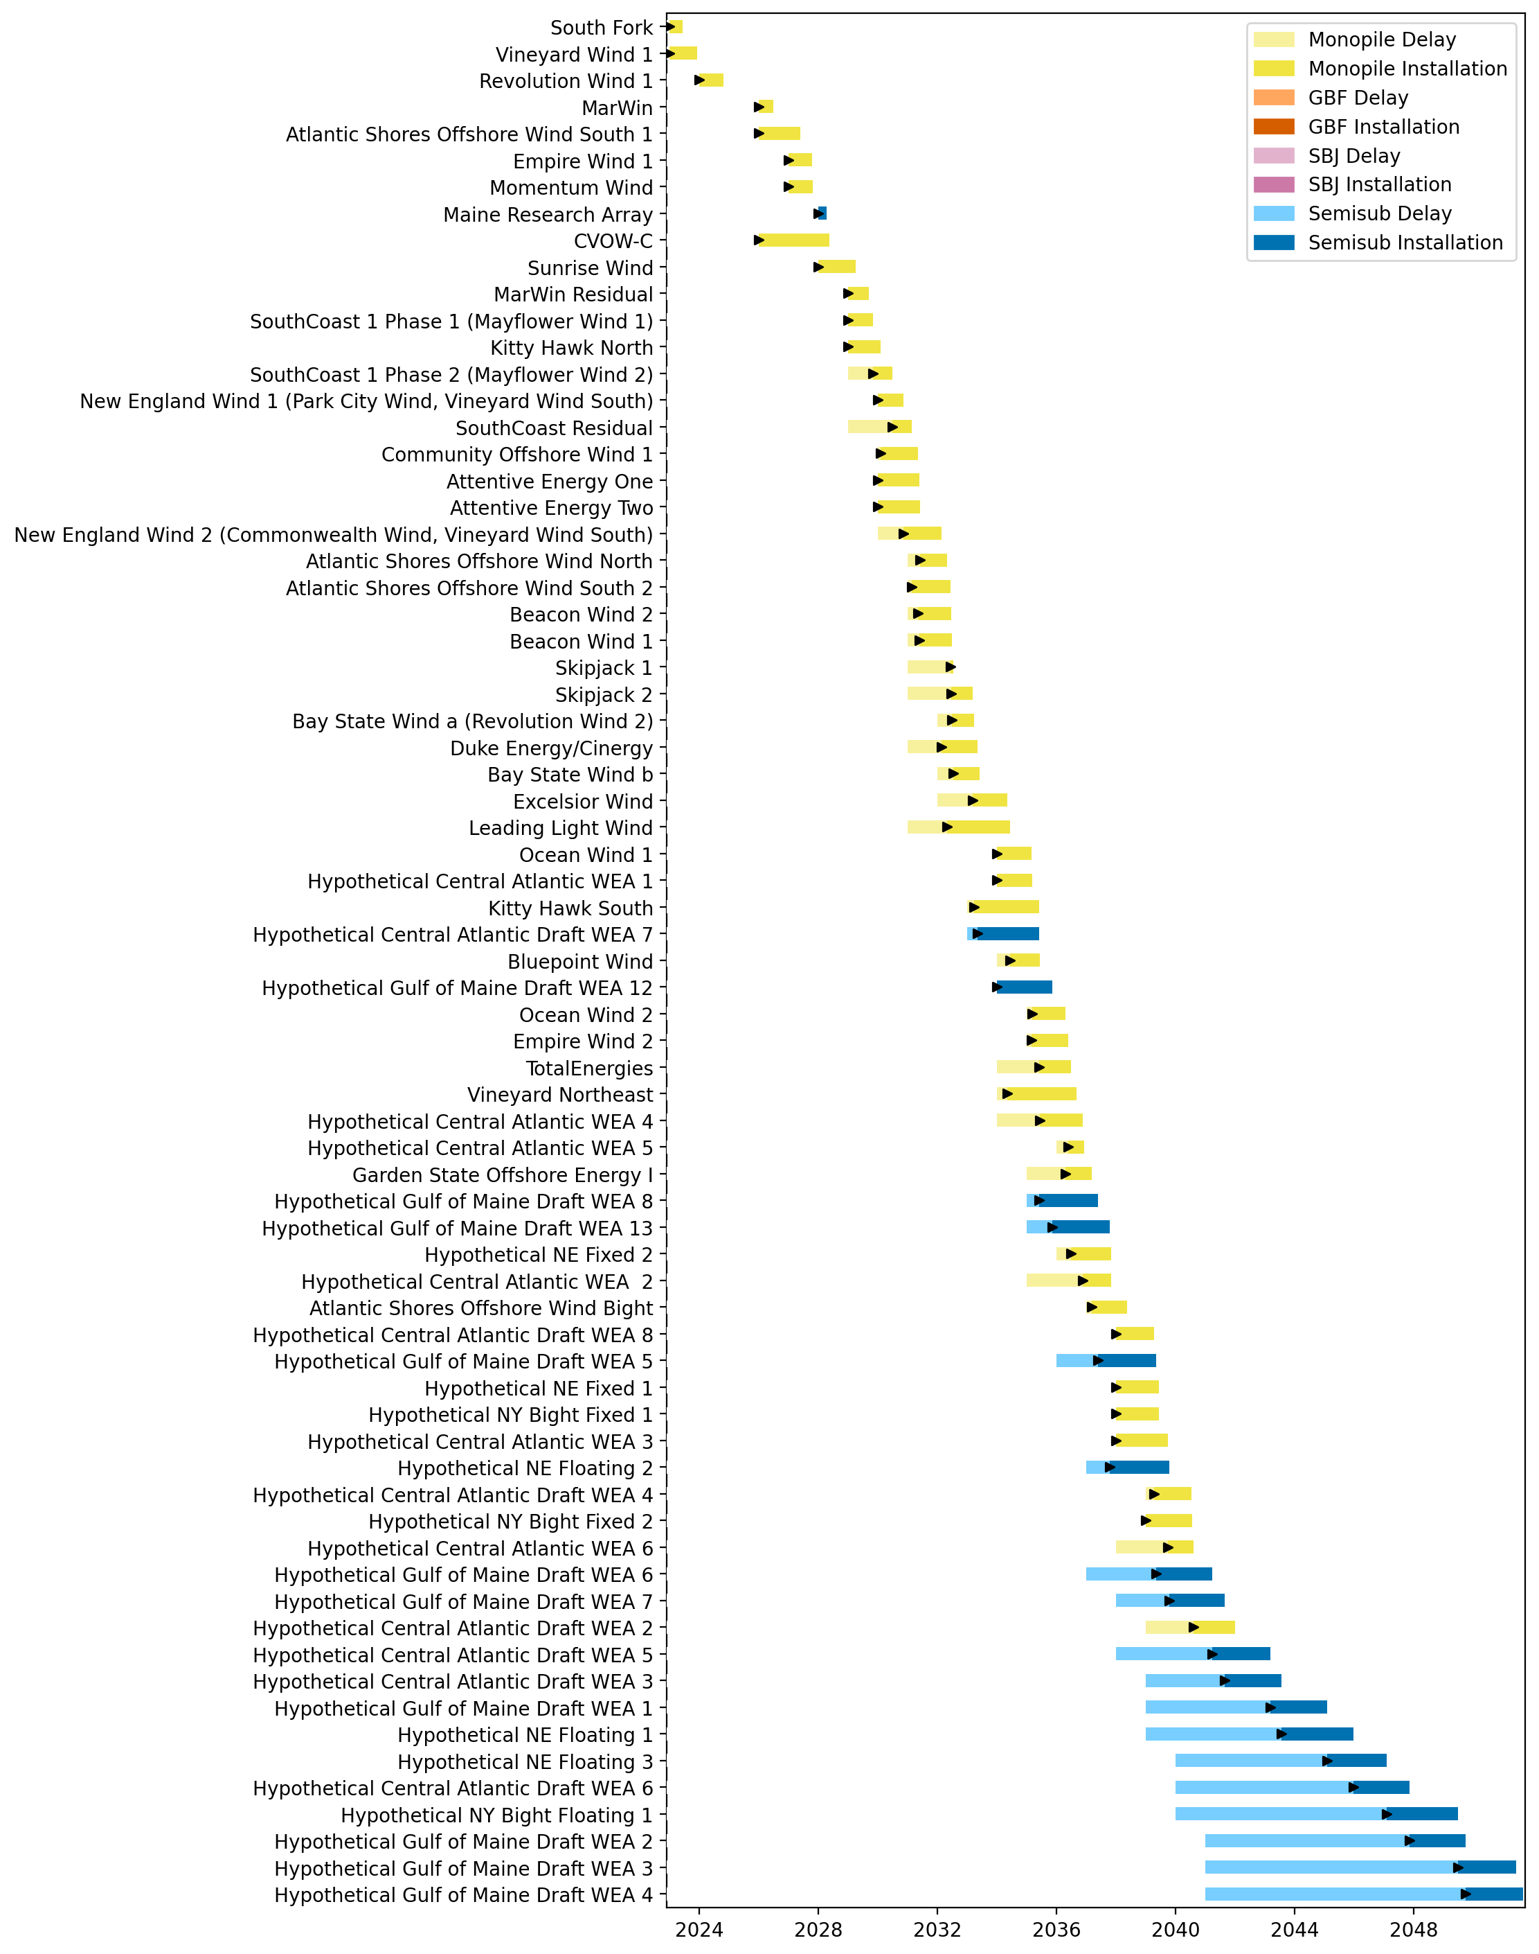
Full Gantt

Slide 3
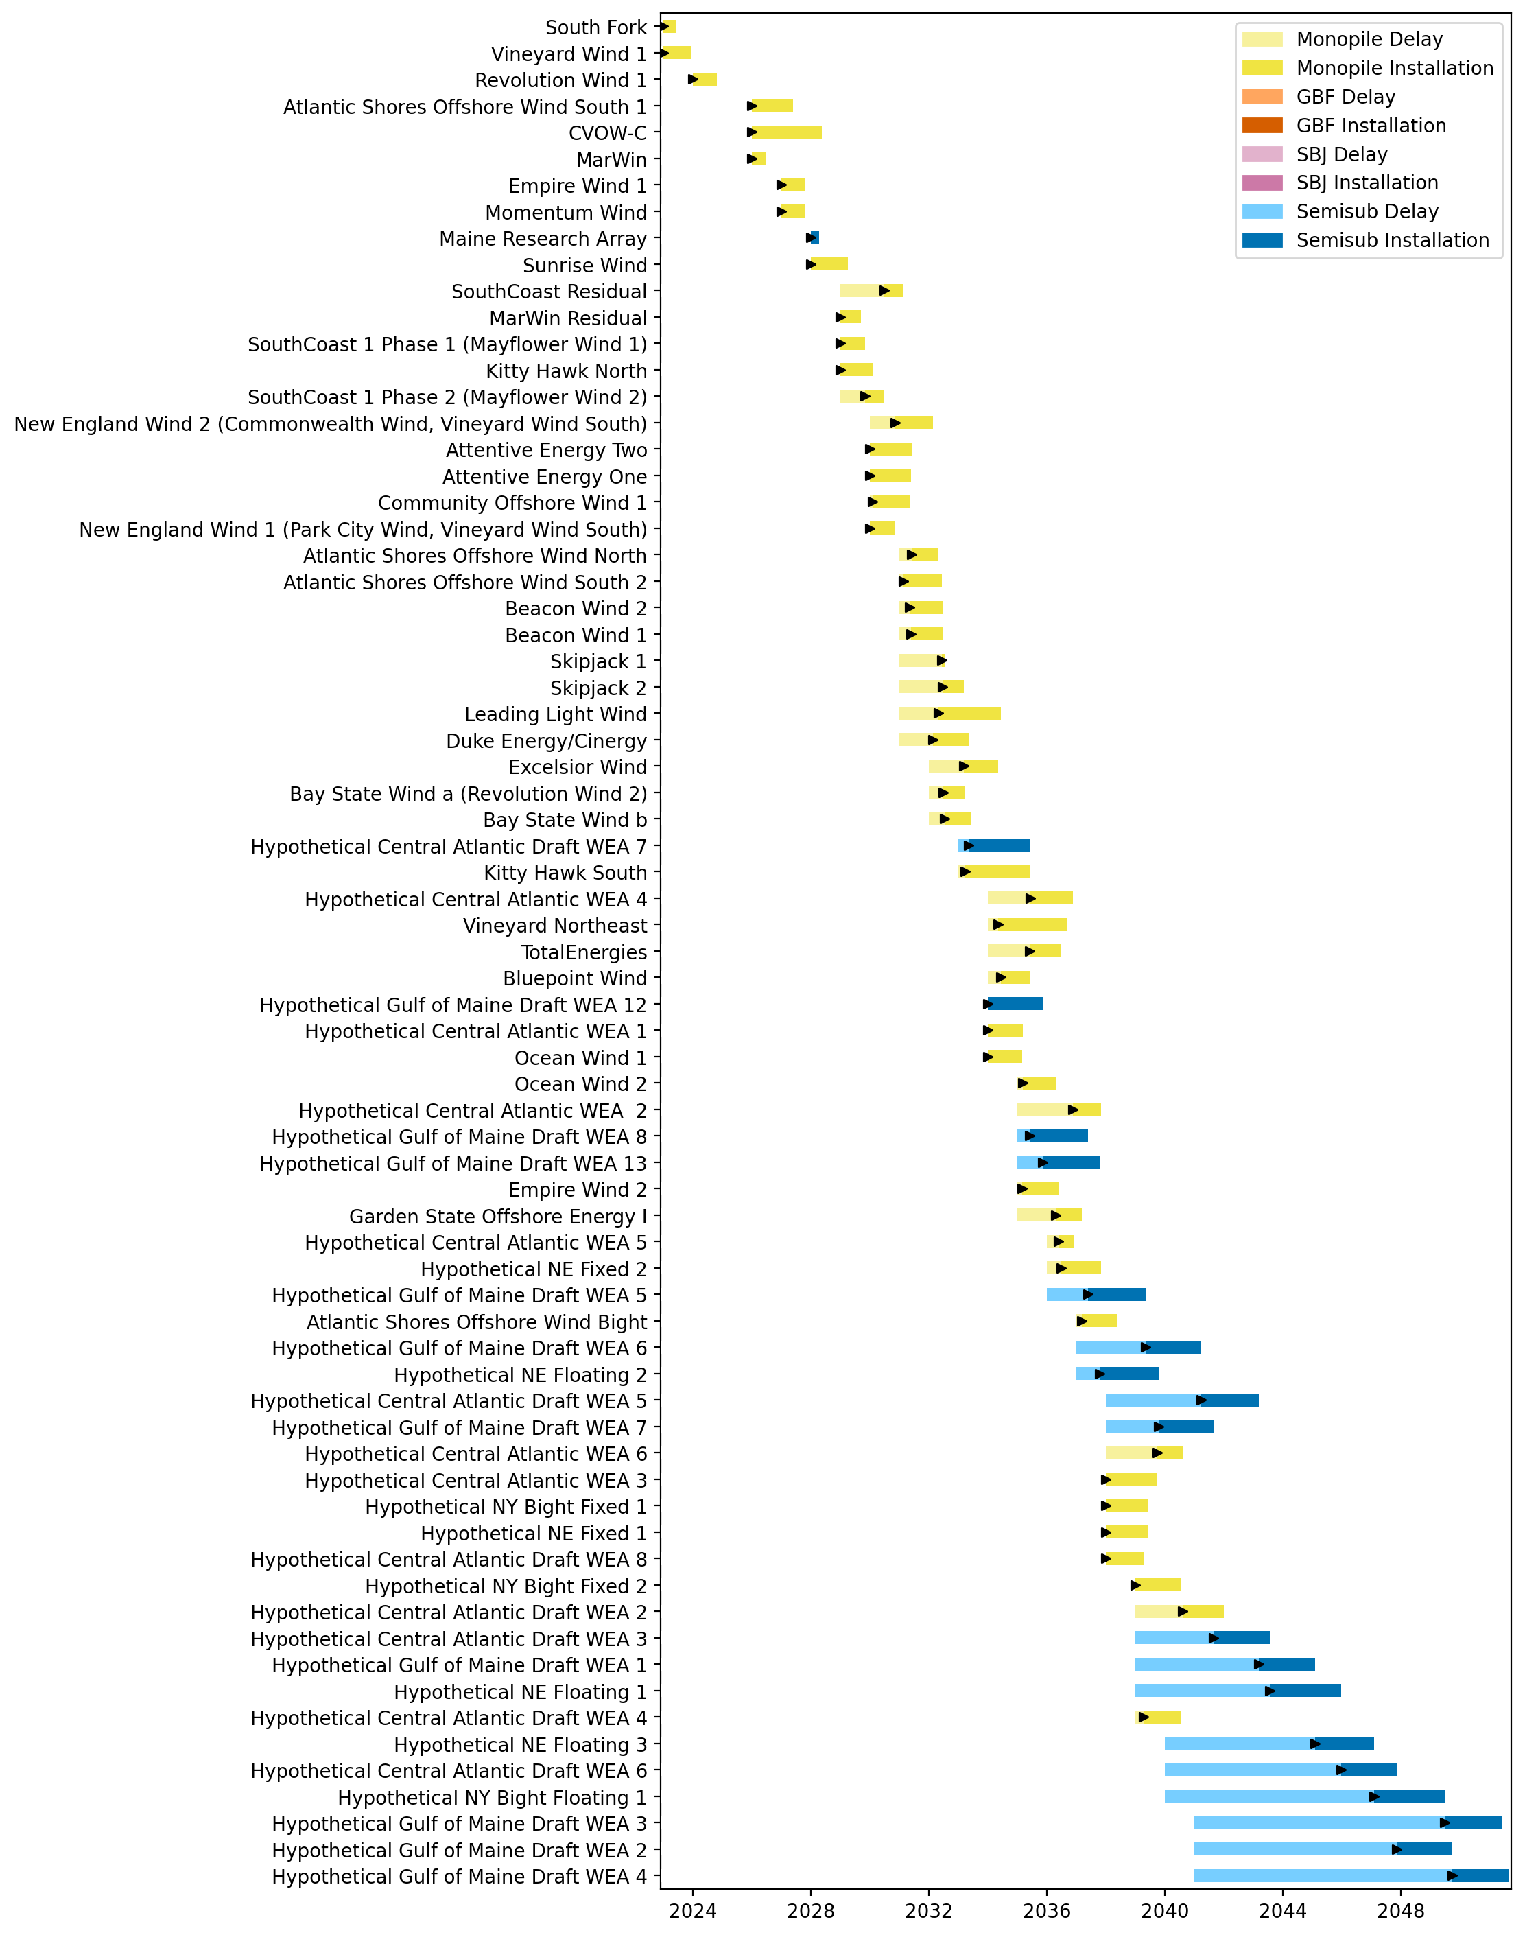
Sorted Full Gantt

Slide 4
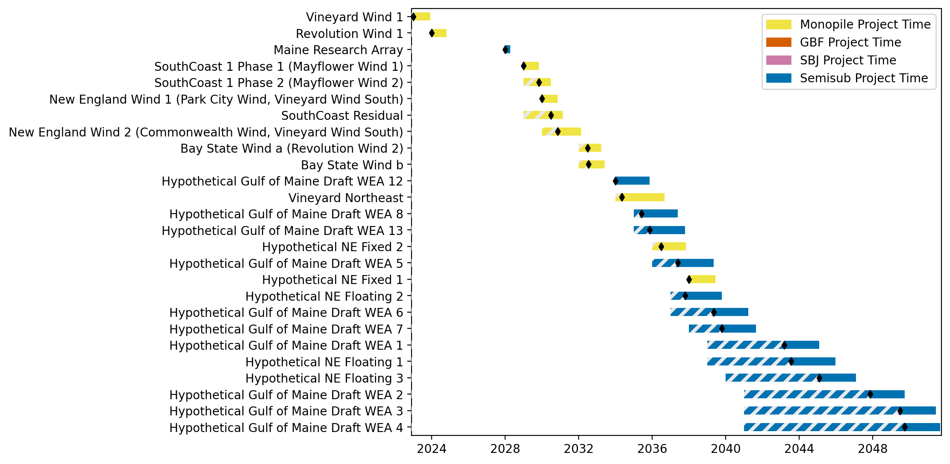
New England Gantt

Slide 5
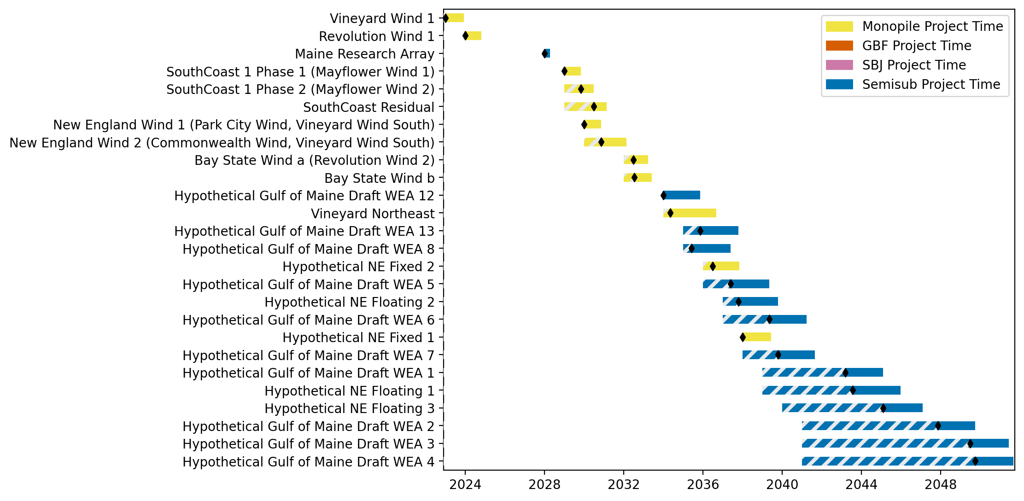
Sorted New England Gantt

Slide 6
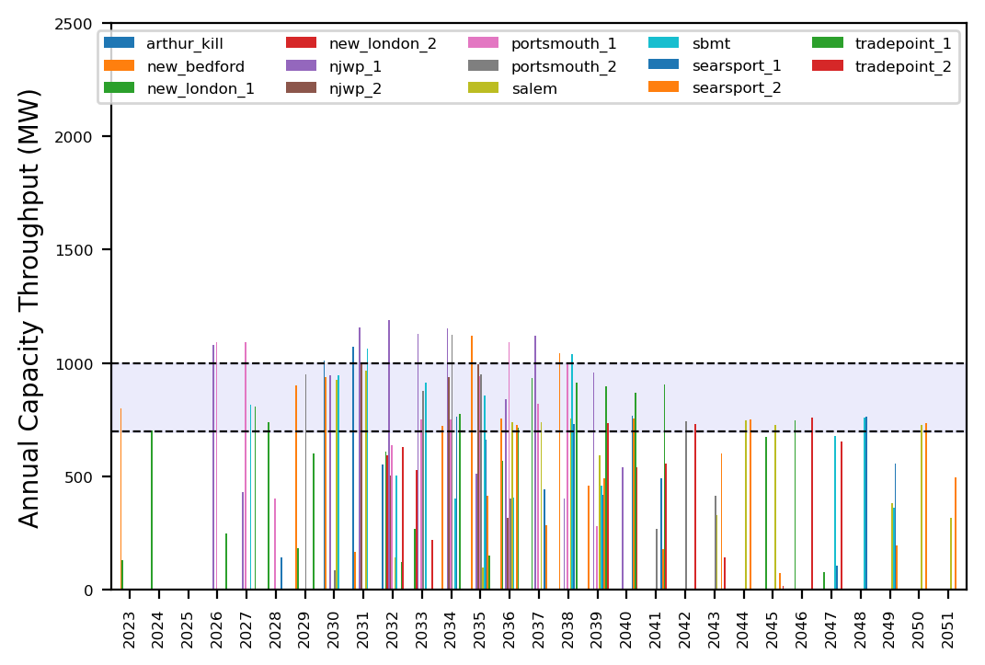
Port Throughput

Slide 7
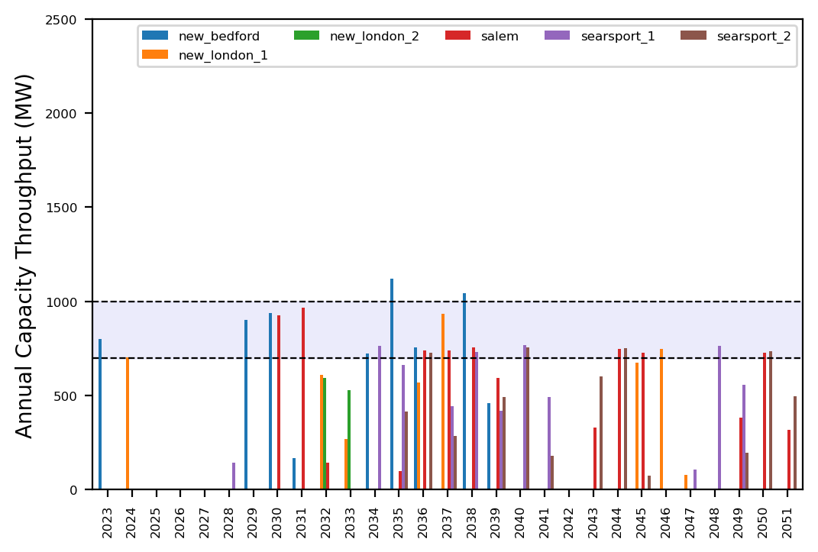
Port Throughput

Slide 8
ne_mono_5wtiv_add_1ahts
All Monopile Pipeline
Add 3 WTIV

Slide 9
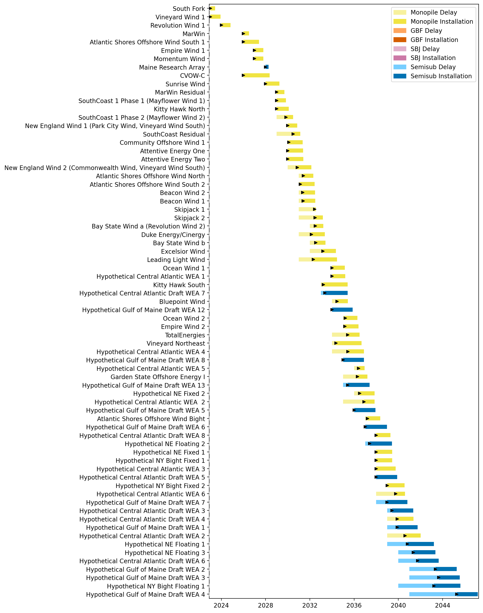
Full Gantt

Slide 10
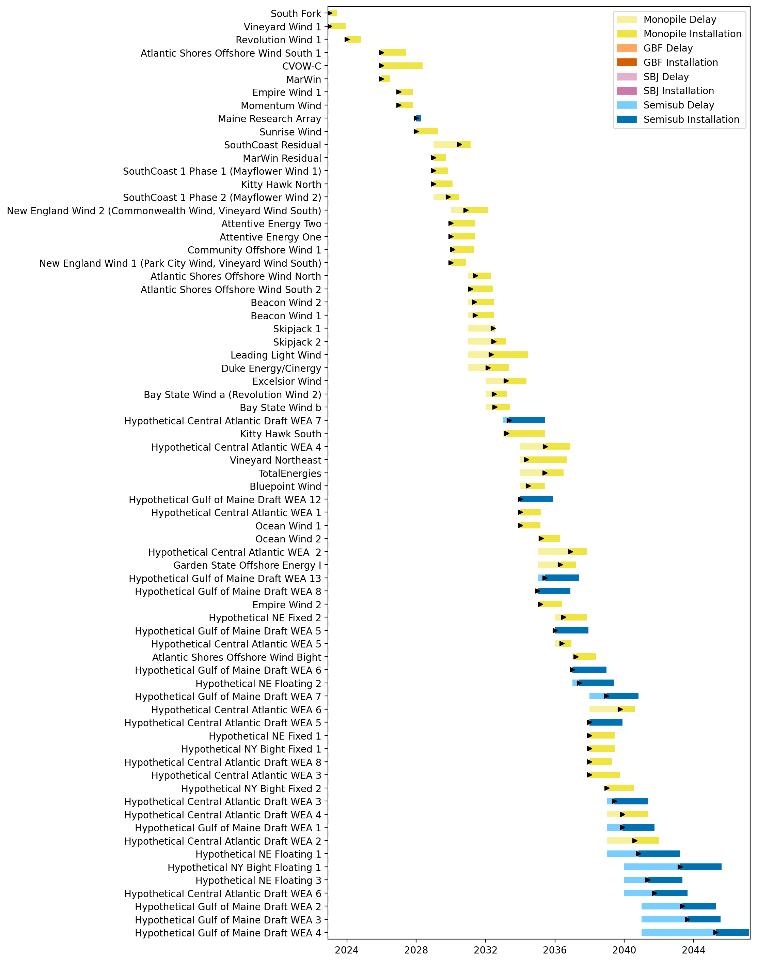
Sorted Full Gantt

Slide 11
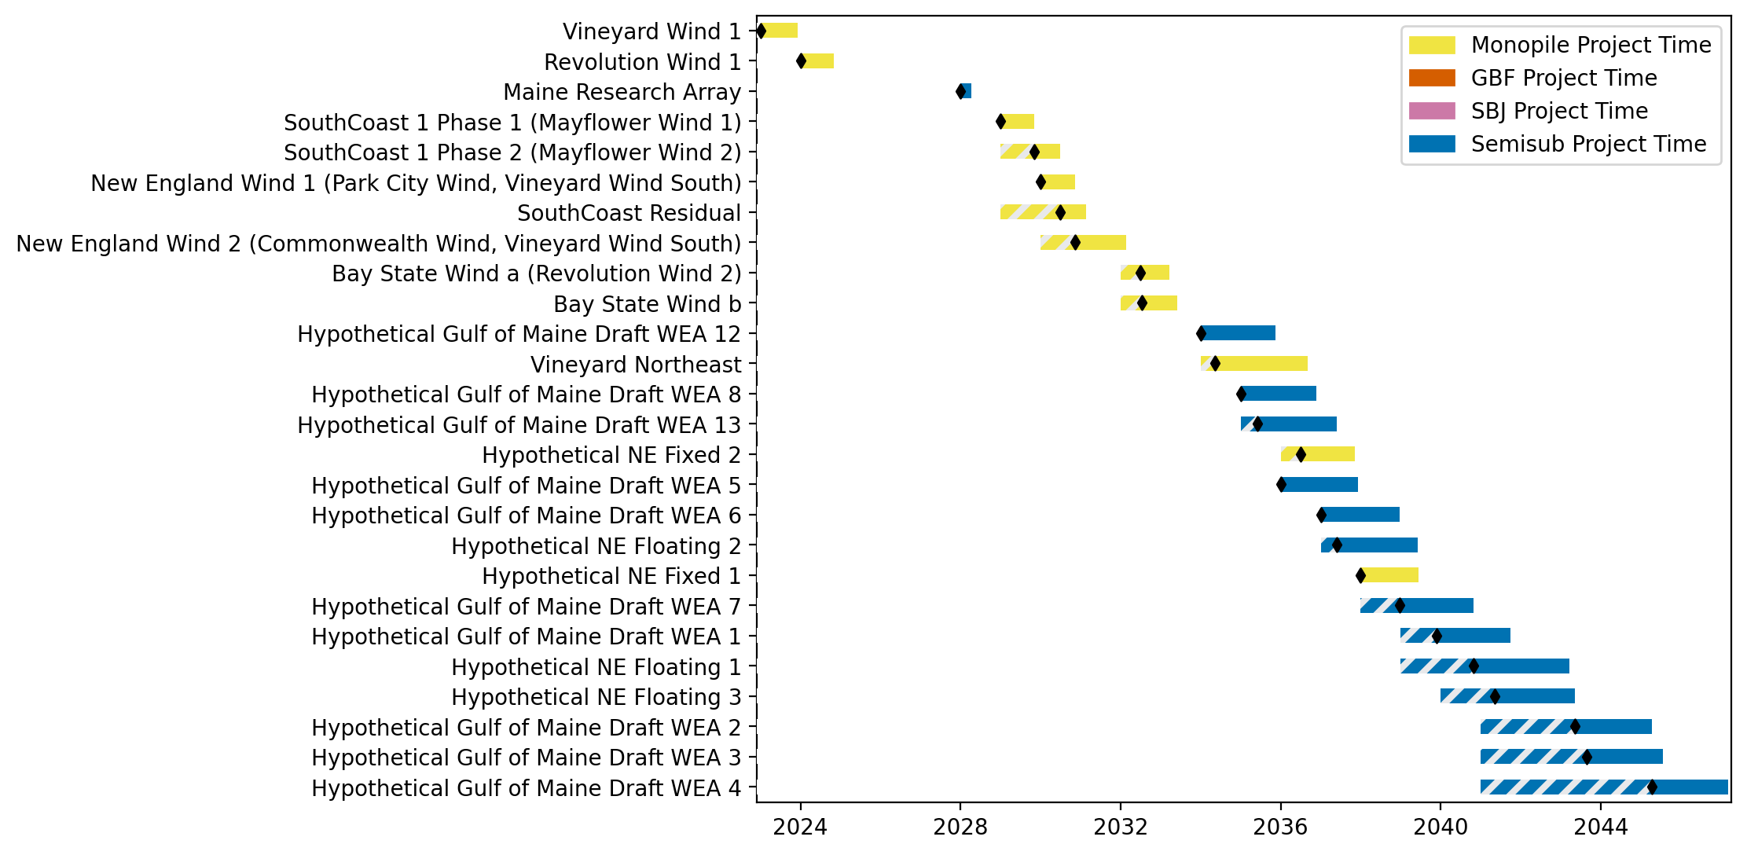
New England Gantt

Slide 12
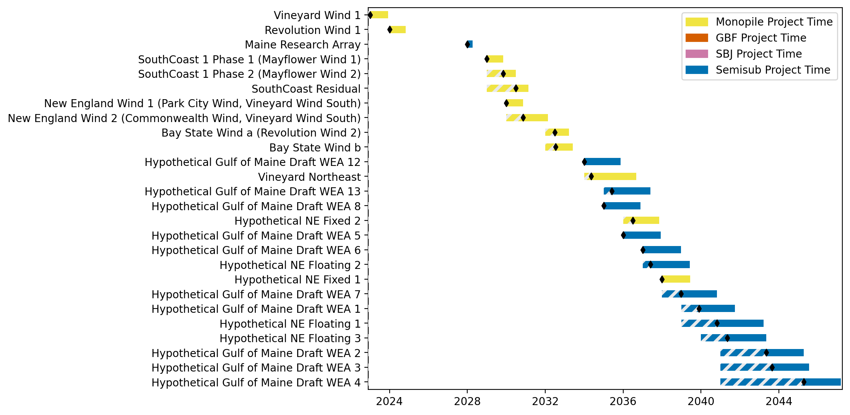
Sorted New England Gantt

Slide 13
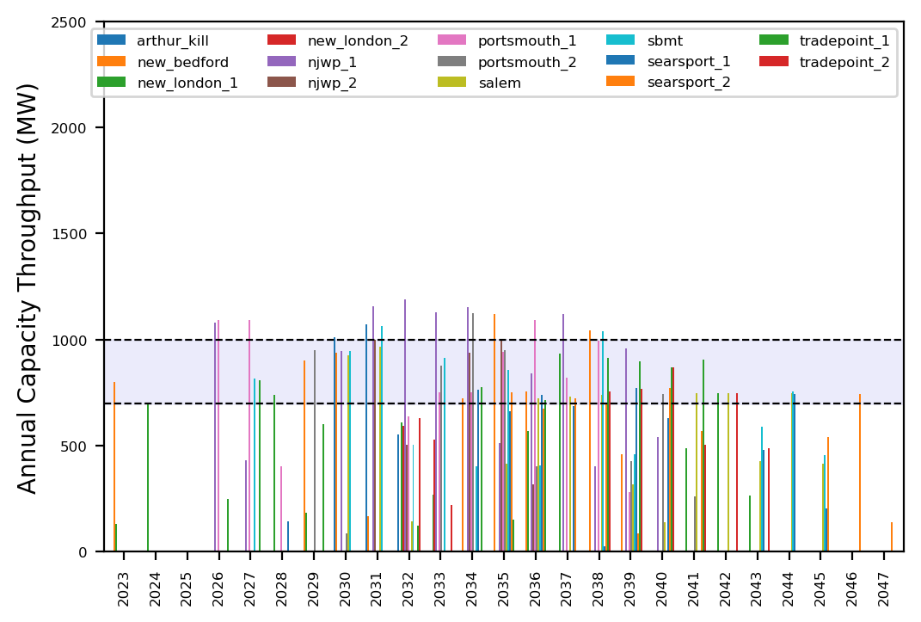
Port Throughput

Slide 14
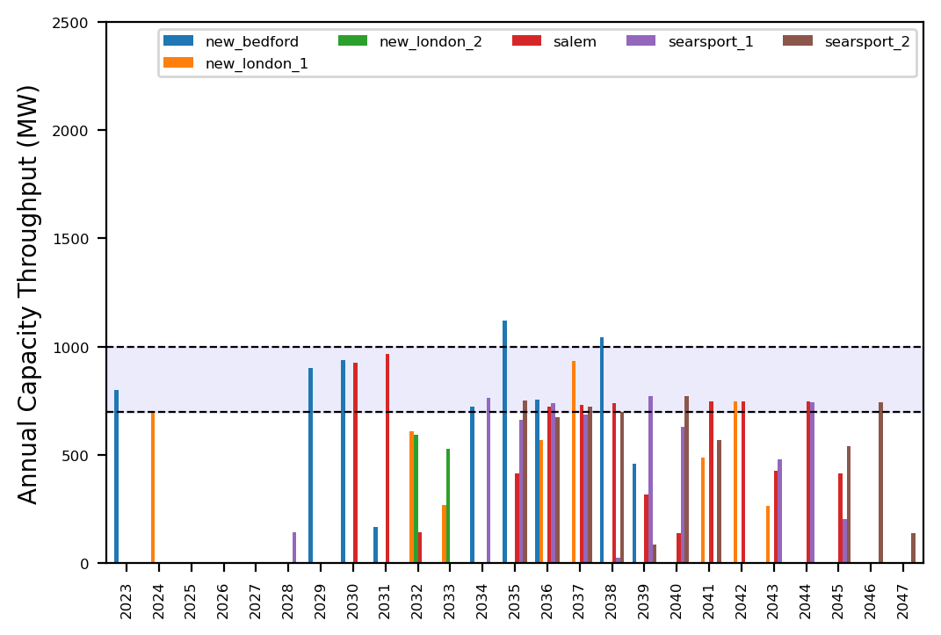
Port Throughput

Slide 15
ne_mono_5wtiv_add_2ahts
All Monopile Pipeline
Add 3 WTIV

Slide 16
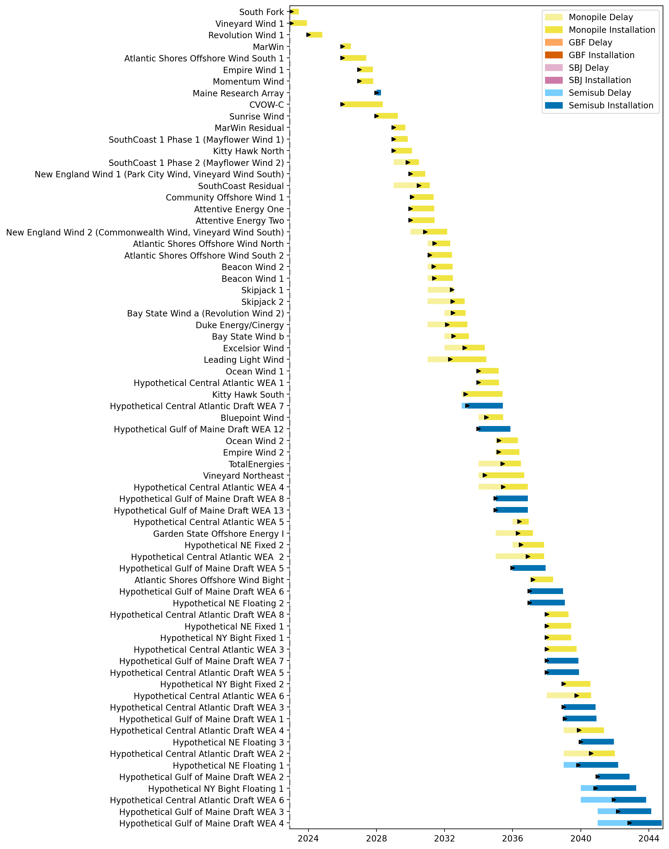
Full Gantt

Slide 17
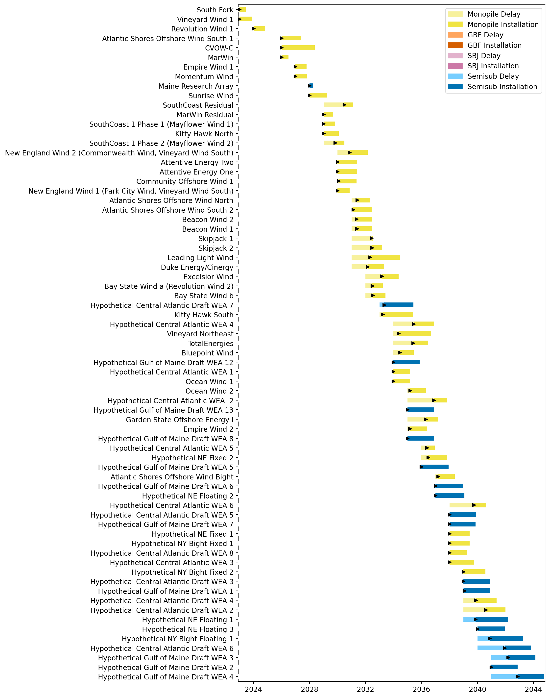
Sorted Full Gantt

Slide 18
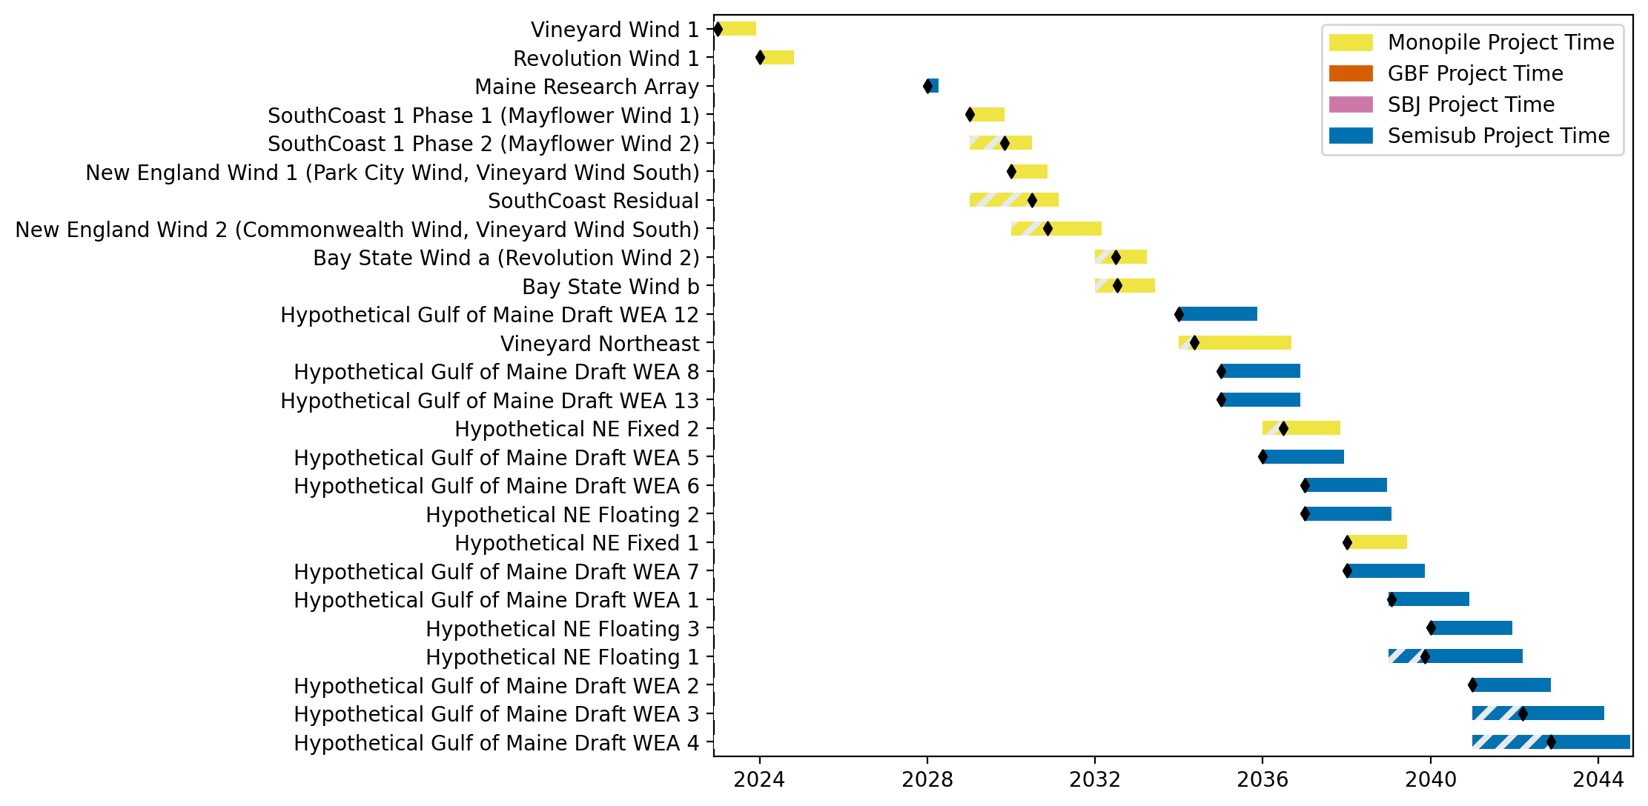
New England Gantt

Slide 19
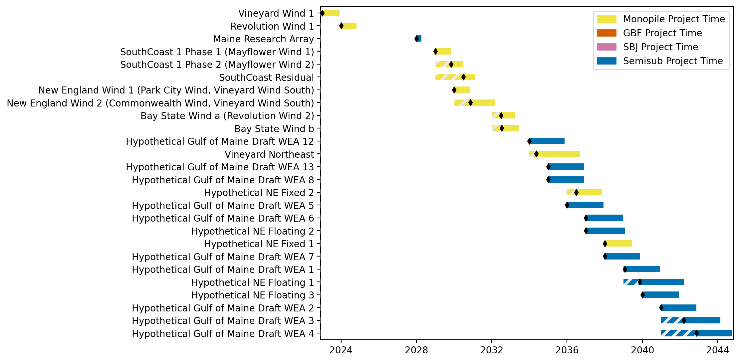
Sorted New England Gantt

Slide 20
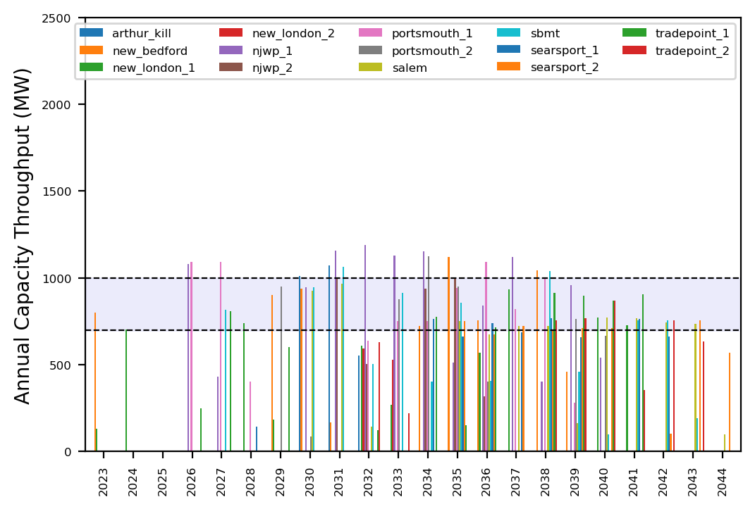
Port Throughput

Slide 21
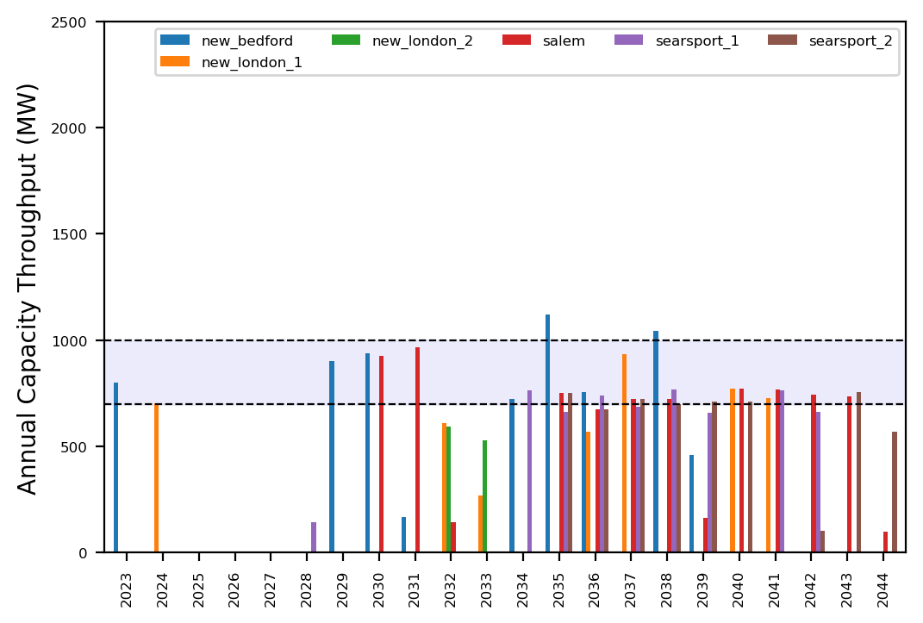
Port Throughput

Slide 22
ne_mono_5wtiv_add_2ahts
All Monopile Pipeline
Add 3 WTIV

Slide 23
Full Gantt

Slide 24
Sorted Full Gantt

Slide 25
New England Gantt

Slide 26
Sorted New England Gantt

Slide 27
Port Throughput

Slide 28
Port Throughput

Slide 29
ne_mono_5wtiv_add_3ahts
All Monopile Pipeline
Add 3 WTIV

Slide 30
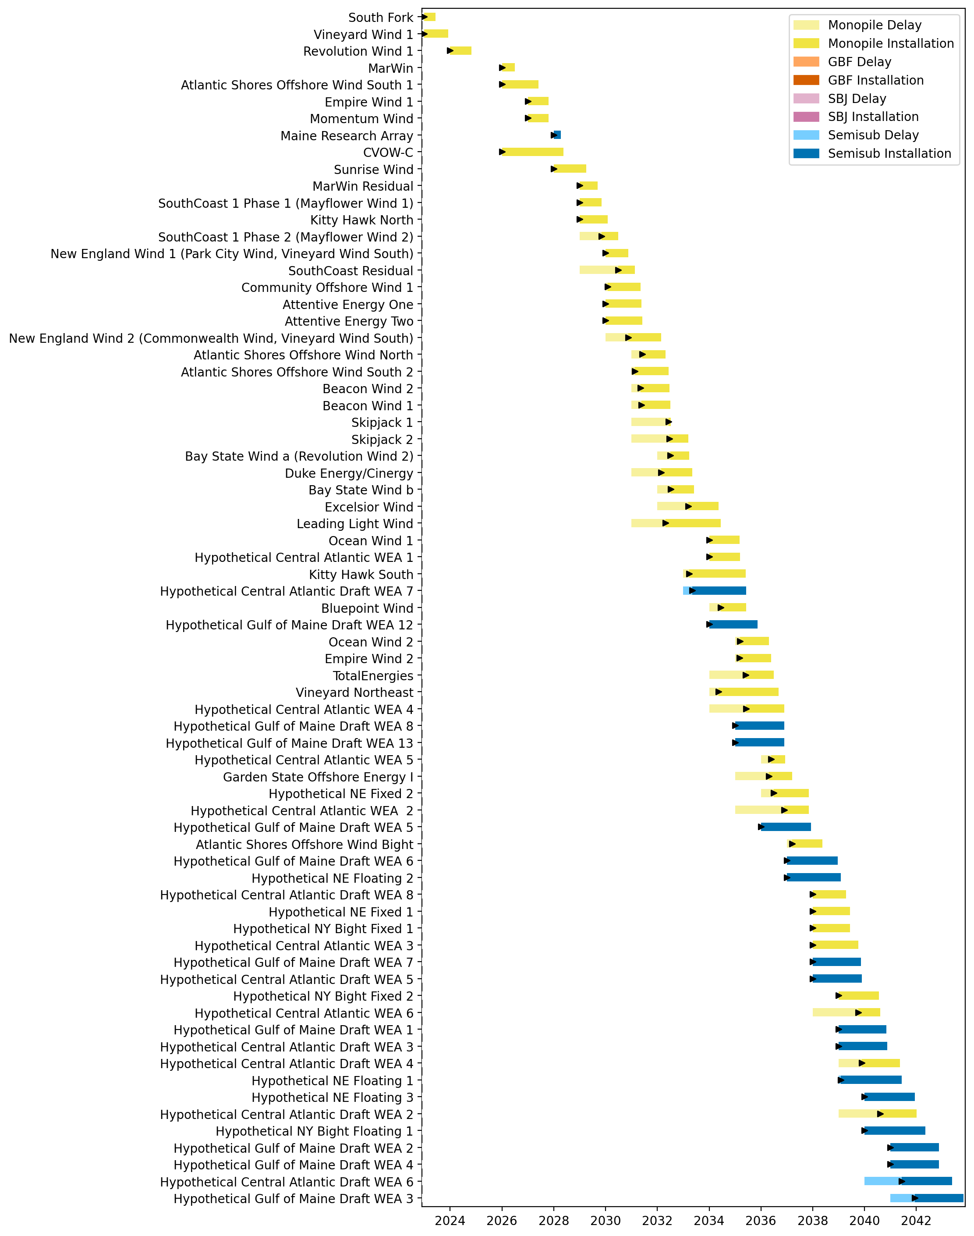
Full Gantt

Slide 31
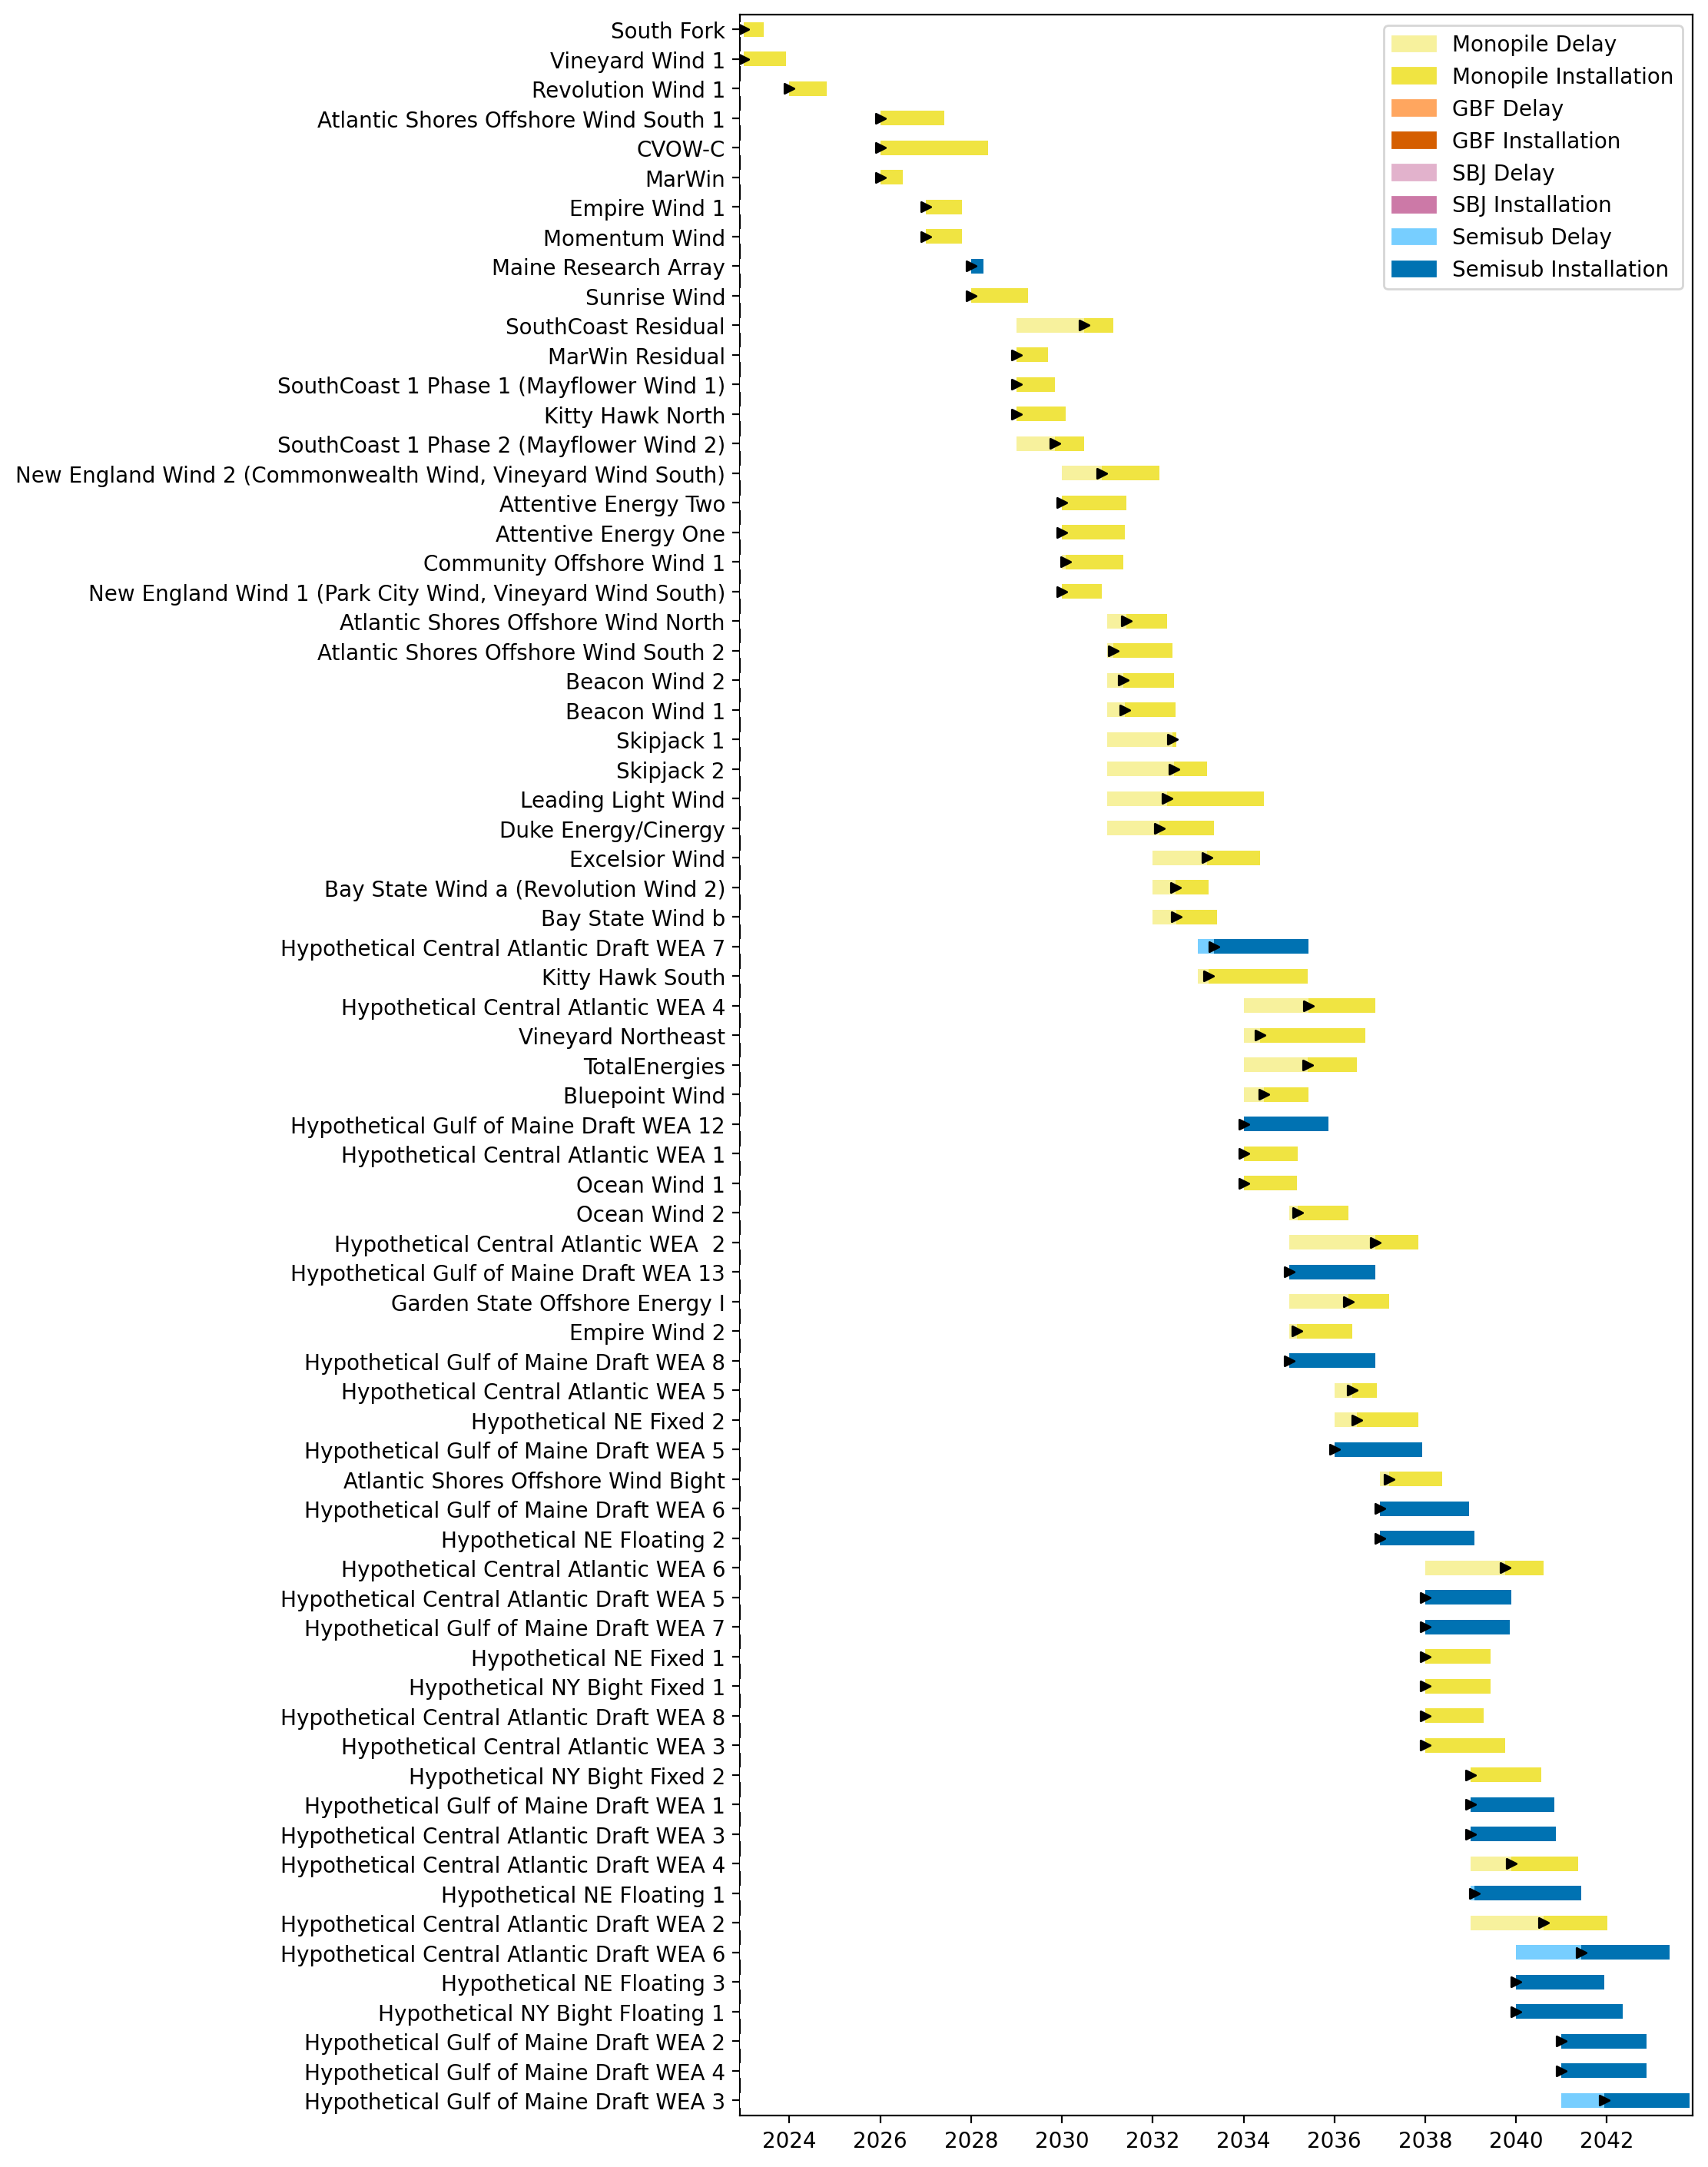
Sorted Full Gantt

Slide 32
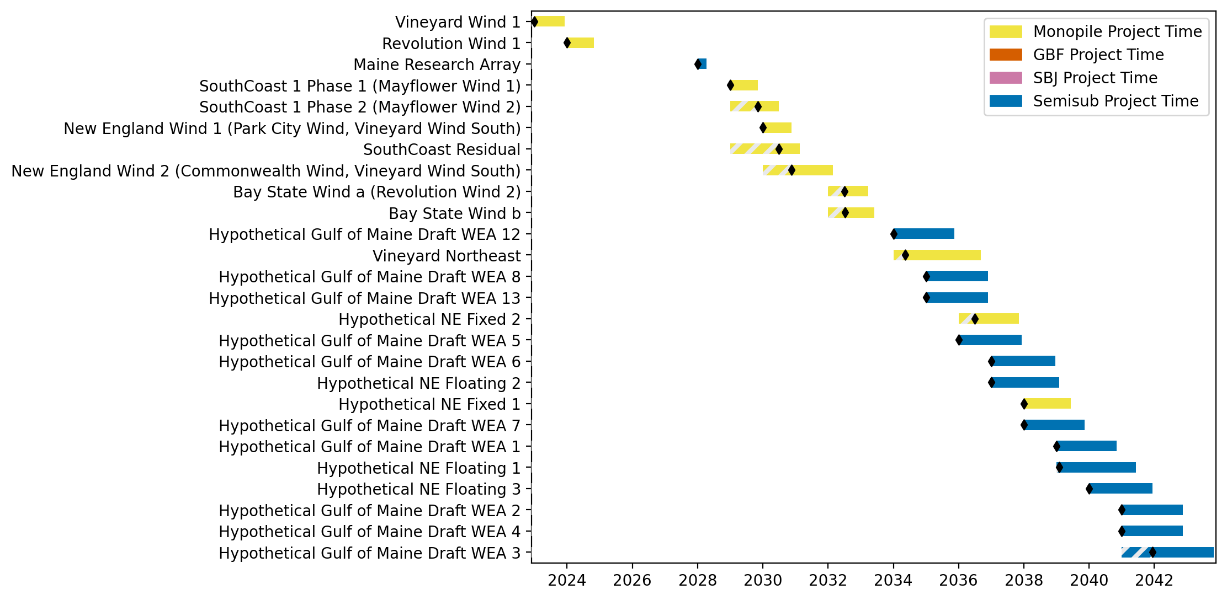
New England Gantt

Slide 33
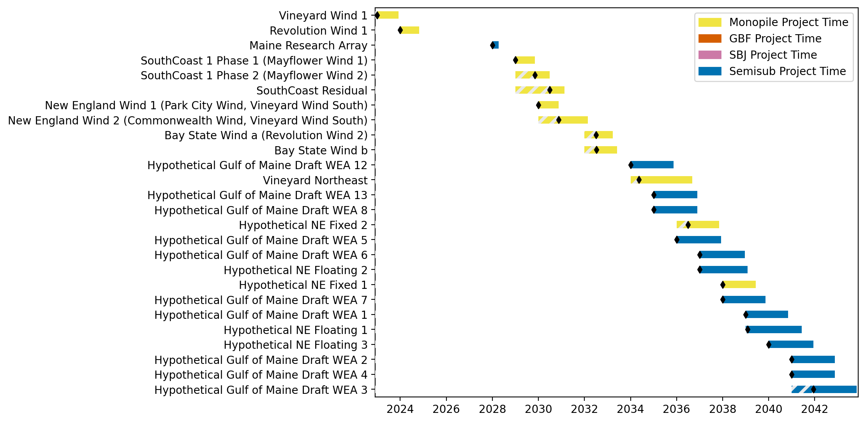
Sorted New England Gantt

Slide 34
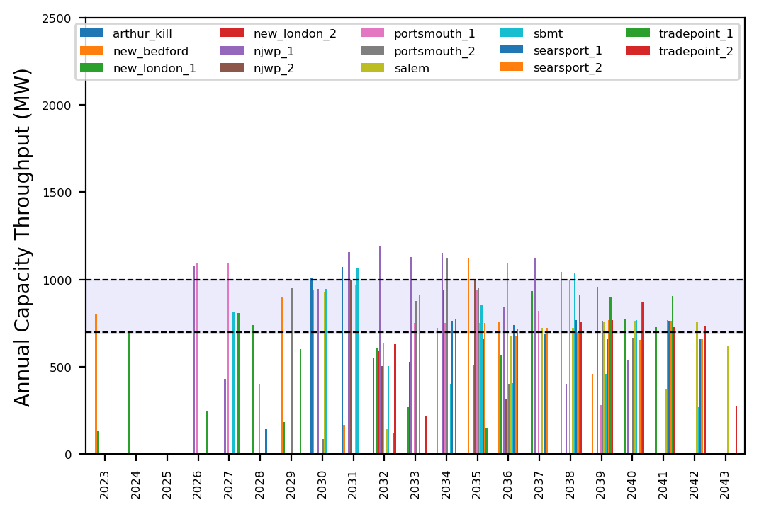
Port Throughput

Slide 35
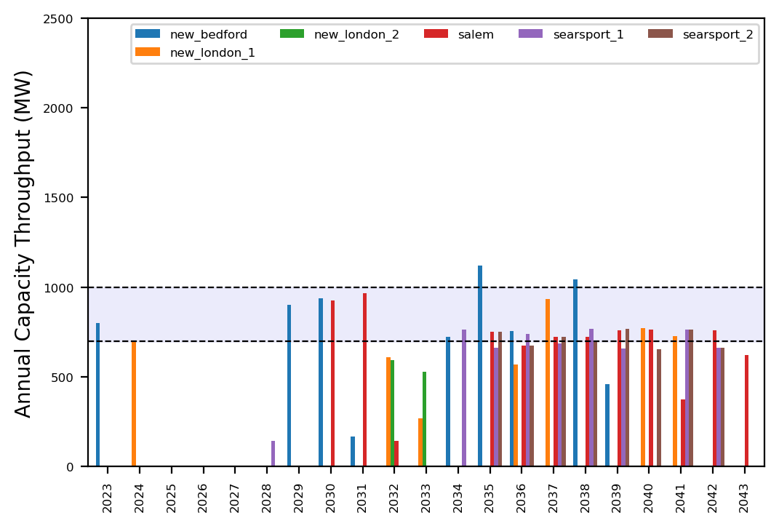
Port Throughput

Slide 36
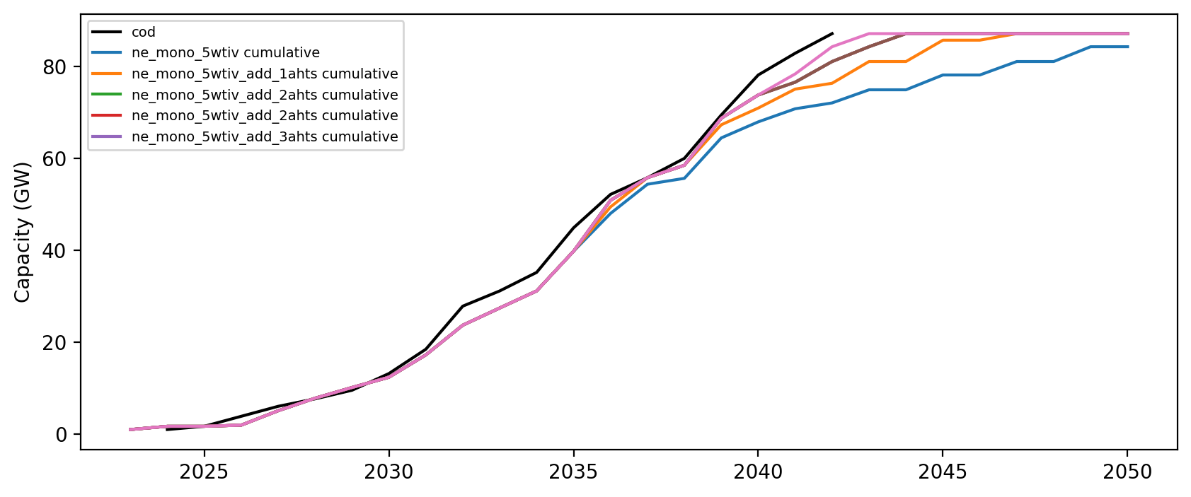
Installed Capacity

